Slide 1
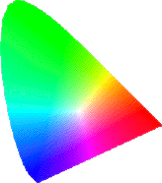
COLOR SPACE
Mohiuddin Ahmad

Slide 2
Contents
Introduction:
  Electromagnetic Radiation
  Spectral power distribution
Color Spaces:
  Linear (RGB, CMYK)
  Artistic View (Munsell, HSV, HLS)
  Standard (CIE-XYZ)
  Perceptual (Luv, Lab)
  Opponent (YIQ, YUV) – used in TV

Slide 3
3D Color Spaces
Three types of cones suggests color is a 3D quantity. How to define 3D color space?
Cubic Color Spaces
Polar Color Spaces
Opponent Color Spaces
Brightness
black-white
G
Hue
blue-yellow
B
R
red-green

Slide 4


RGB (additive) & CMYK(subtractive) Color Model
RGB = Red, Green, Blue
The mixing of “light”
Primary: Cyan, Magenta, Yellow,
The mixing of “pigment”
CMYK Color Model
A pigment is a material that changes the color of reflected or transmitted light as the result of wavelength-selective absorption

Slide 5
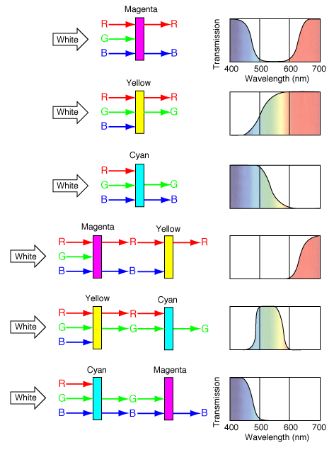
Subtractive Color Mixing
Why?
Pigments absorb light
Thinking:
the Color Filters
Question:
Yellow + Cyan=?

Slide 6
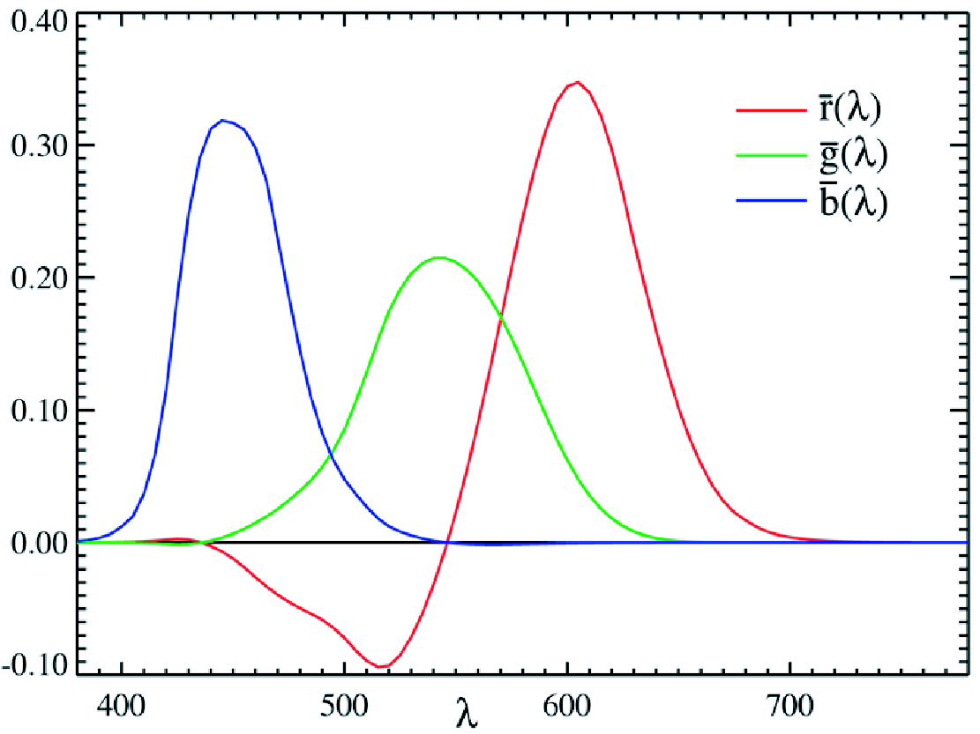
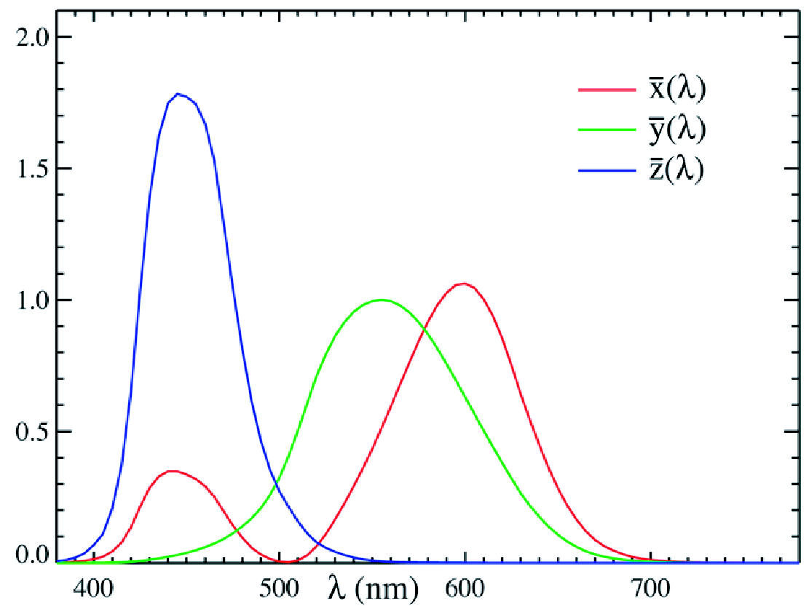
CIE Color Matching Functions
CIE RGB Matching Functions CIE XYZ Matching Functions

Slide 7

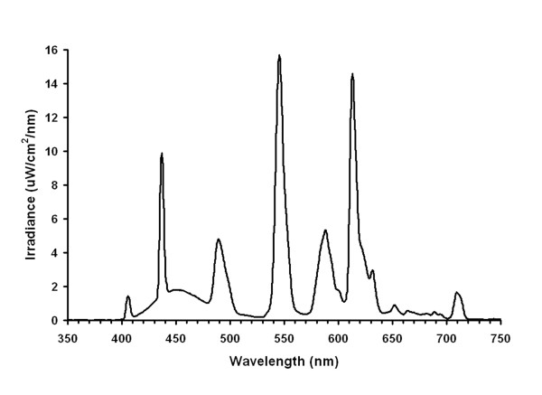
RGB from Spectrum
RGB = x dλ

Slide 8

XYZ from Spectrum
XYZ = x dλ

Slide 9
CIE xyY from CIE XYZ
CIE xyY color model is used to catalog colors:
x = X / (X + Y + Z)
y = Y / (X + Y + Z)
Y = luminance

Slide 10
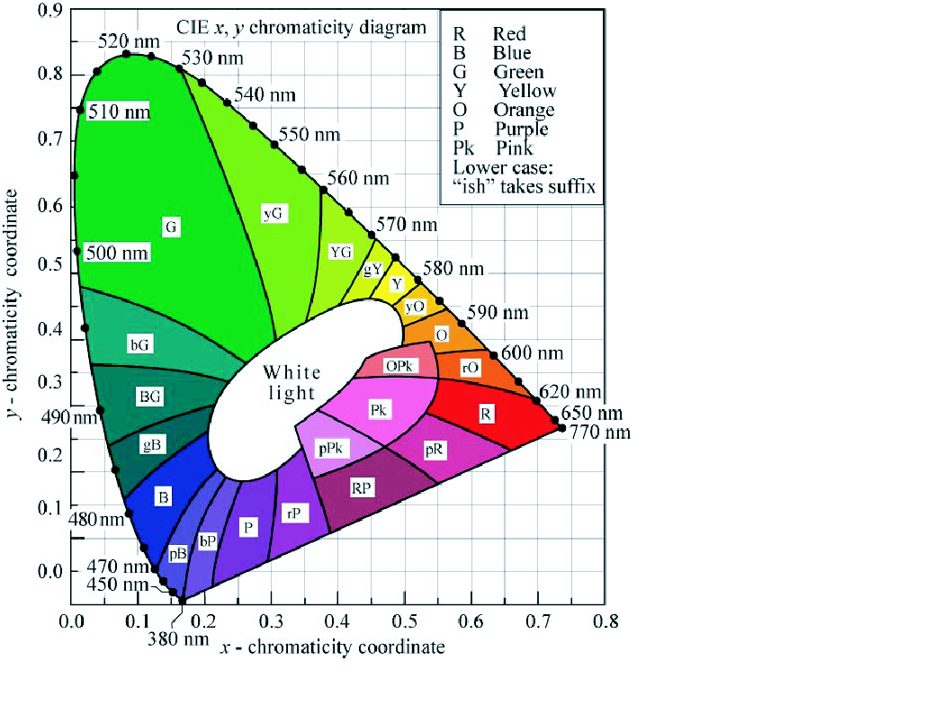
CIE xyY Color Cone

Slide 11
The CIE System
CIE-Commission internationale de l'Eclairage (International commission of illumination)
  CIE 1931 XYZ system
  One of the color spaces
  The first mathematical defined color space
  Three parameter:
  X, Y, Z
  or Y (brightness), x, y (chroma)

Slide 12
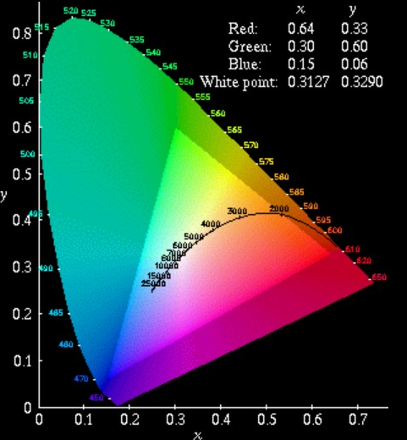
The CIE System
CIE Chromaticity Diagram
Spectral Locus
Parameter x, y

Slide 13
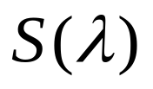
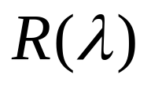
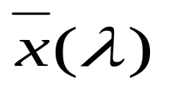
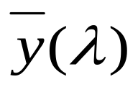
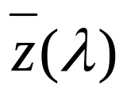
The CIE System
How do we get the parameters from a specified color or object?
The spectral power distribution of the illuminant:
spectral reflectance factor of the object :
Matching function:

Slide 14
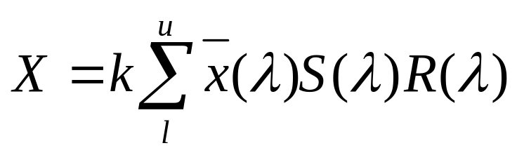
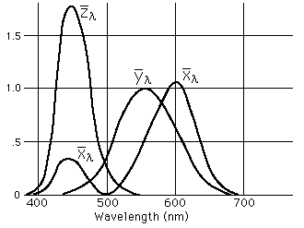
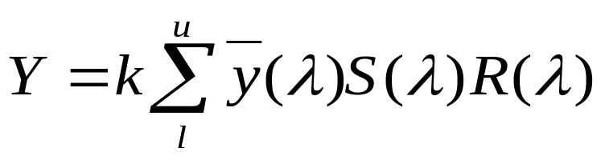
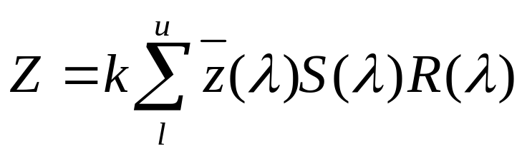
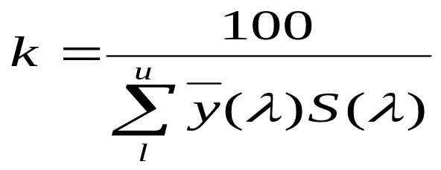
The CIE System

Slide 15
RGB Image
111
14
126
36
12
36
36
111
36
12
17
111
200
36
12
36
14
36
36
17
111
200
36
12
200
111
14
126
17
111
14
36
12
36
14
36
10
128
126
200
12
111
36
36
111
36
14
36
17
111
14
126
17
111
17
36
36
14
36
72
17
126
72
126
17
111
12
126
200
36
12
36
12
17
126
17
111
200
200
36
12
36
12
126
14
200
36
12
126
17
72
12
17
111
14
36
128
126
200
12
111
126
200
111
14
36
72
10
200
36
12
36
14
36
111
14
126
36
12
36
36
12
17
72
106
155
17
200
36
111
36
14
14
126
36
17
72
111
36
111
36
12
17
111
12
36
17
36
126
111
17
36
111
14
200
36
17
111
200
36
12
36
14
17
200
126
36
72
12
126
126
17
17
111
14
36
12
36
14
36
126
200
200
36
111
12
14
36
36
12
72
126
17
111
14
126
17
111
36
72
12
12
17
17
72
111
106
14
155
36
12
126
200
36
12
36

Slide 16
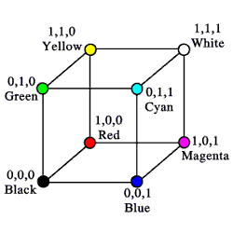
CMYK Color Model
CMYK = Cyan, Magenta, Yellow, black
Cyan – removes Red
transmit
B
G
R
Magenta – removes Green
B
G
R
Yellow – removes Blue
B
G
R
Black – removes all

Slide 17
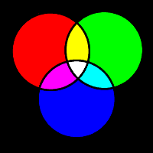
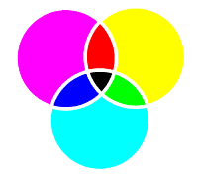
Combining Colors
Additive (RGB)
Subtractive (CMYK)

Slide 18
Example: red = magenta + yellow
B
G
R
magenta
+
B
G
R
yellow
B
G
R
=
red
R
B
G
R

Slide 19
CMY + Black
C + M + Y = K (black)
Using three inks for black is expensive
C+M+Y = dark brown not black
Black instead of C+M+Y is crisper with more contrast
=
+
100
50
70
50
50
0
20
C
M
Y
K
C
M
Y

Slide 20
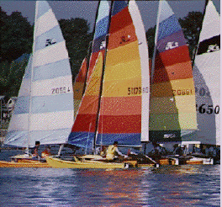
Example

Slide 21
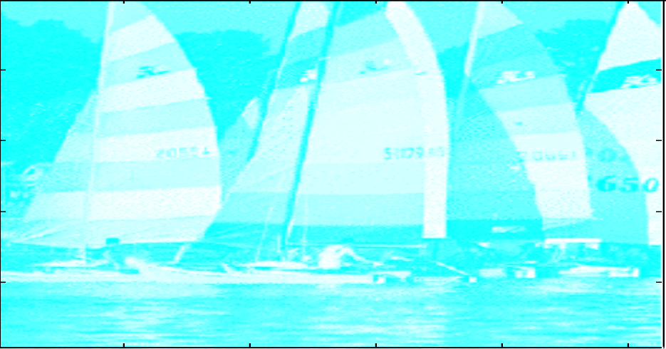
Example - C

Slide 22
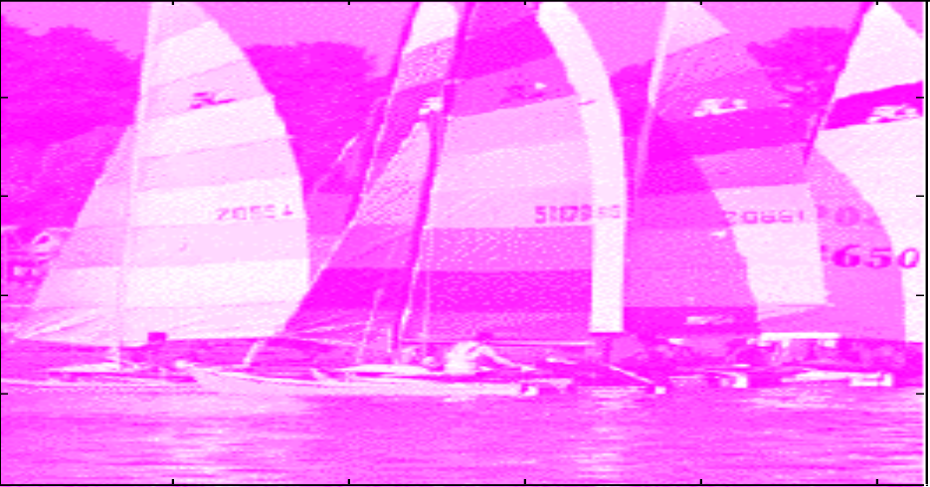
Example - M

Slide 23
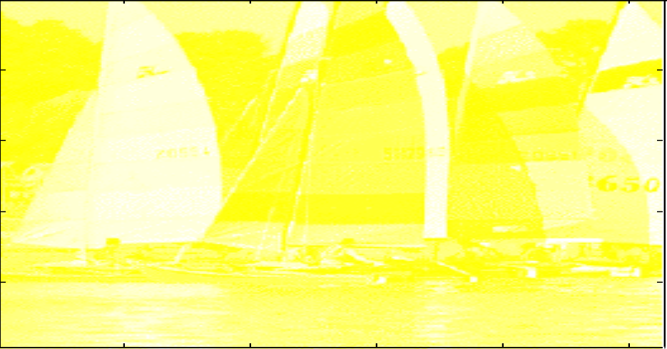
Example - Y

Slide 24
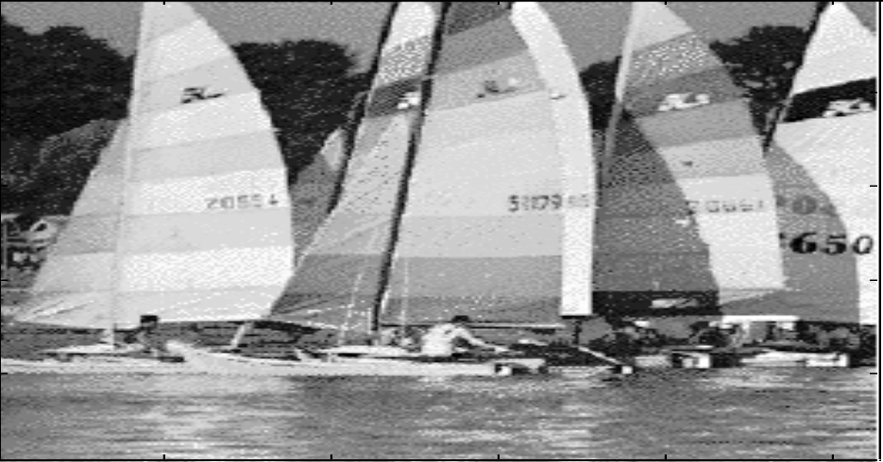
Example - K

Slide 25
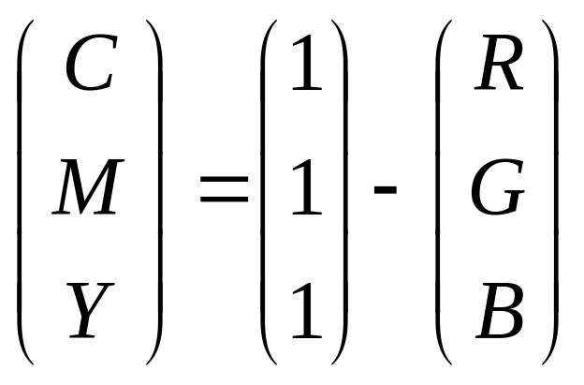
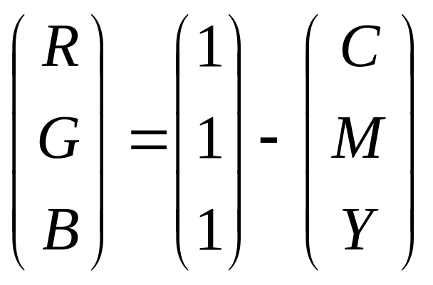
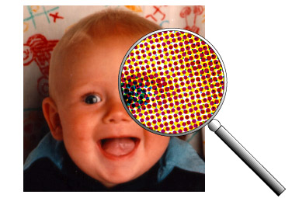
From RGB to CMY

Slide 26
Color Spaces
Linear (RGB, CMYK)
Artistic View (Munsell, HSV, HLS)
Standard (CIE-XYZ)
Perceptual (LUV, Lab)
Opponent (YIQ, YUV) – used in TV

Slide 27

The Artist Point of View
Hue - The color we see (red, green, purple)
Saturation - How far is the color from gray (pink is less saturated than red, sky blue is less saturated than royal blue)
Brightness/Lightness (Luminance) - How bright is the color
white

Slide 28


Artist’s Color
Hue
Saturation
Value

Slide 29
Value
Luminance
Dark to Light
Value range
  High key
  Middle key
  Low key

Slide 30

Hue - Paint Mixing
Physical mix of opaque (not transparent) paints
Primary: RYB
Secondary: OGV
Neutral: R + Y + B

Slide 31

Hue - Ink Mixing
Subtractive mix of transparent inks
Primary: CMY
Secondary: RGB
~Black: C + M + Y
Actually use CMYK
to get true black

Slide 32
Hue - Ink Mixing
Assumption: ink printed on pure white paper
CMY = White – RGB:
  C = 1 – R, M = 1 – G, Y = 1 – B
CMYK from CMY (K is black ink):
  K = min(C, M, Y)
  C = C – K, M = M – K, Y = Y - K

Slide 33

Hue - Light Mixing
Additive mix of colored lights
Primary: RGB
Secondary: CMY
White = R + G + B
Show demonstration of optical mixing

Slide 34

Saturation
Purity of color

Slide 35
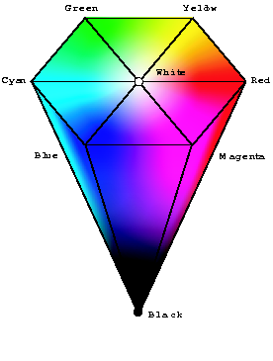
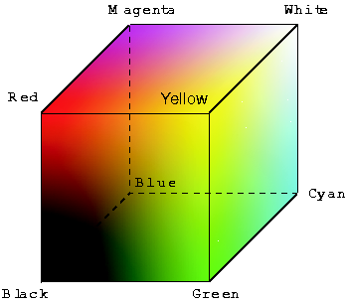
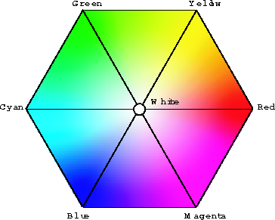
HSV color model
  RGB cube
  HSV top view
  HSV cone
HSV is a projection of the RGB space

Slide 36
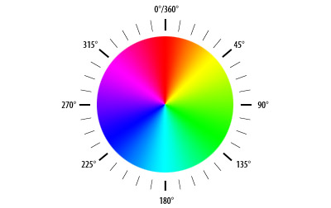
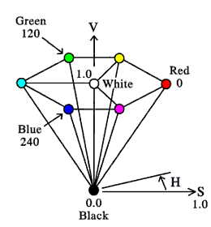


HSV/HSB Color Space
HSV = Hue Saturation Value
HSB = Hue Saturation Brightness
Saturation Scale
Brightness Scale

Slide 37
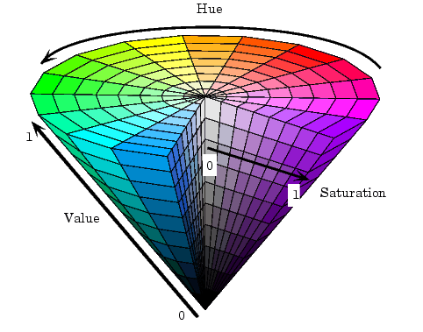
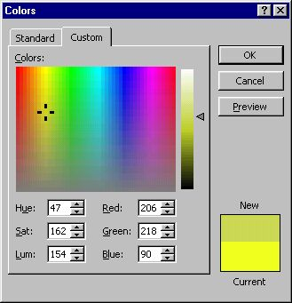
HSV
Value
Saturation
Hue

Slide 38
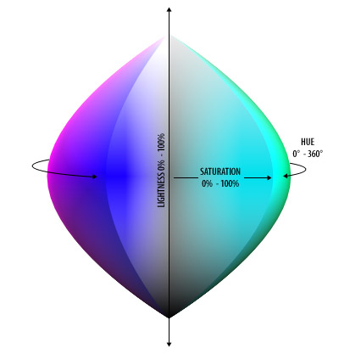
HLS Color Space
HLS = Hue Lightness Saturation
V
green
120°
yellow
cyan
0.5
red
0°
Blue
240°
magenta
H
0.0
S
black

Slide 39
Color Spaces
Linear (RGB, CMYK)
Artistic View (Munsell, HSV, HLS)
Standard (CIE-XYZ)
Perceptual (Luv, Lab)
Opponent (YIQ, YUV) – used in TV

Slide 40


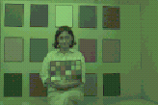
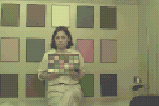

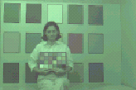


CIE Color Standard
Why do we need a standard ?
  RGB differ from one device to another

Slide 41
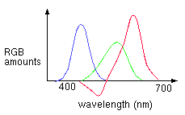
CIE Color Standard
Why do we need a standard ?
  RGB differ from one device to another
  RGB cannot represent all colors
RGB Color Matching Functions

Slide 42
CIE Color Standard - 1931
CIE - Commision Internationale d’Eclairage
1931 - defined a standard system for color representation.
XYZ tristimulus coordinate system.
X
Y
Z

Slide 43
XYZ Spectral Power Distribution
Non negative over the visible wavelengths.
The 3 primaries associated with x y z spectral power distribution are unrealizable
(negative power in some of the wavelengths).
y was chosen to equal luminance of monochromatic lights.
1.8
1.4
z(λ)
y(λ)
1
Tristimulus values
x(λ)
0.6
0.2
400
500
600
700
Wavelength (nm)

Slide 44
RGB to XYZ
RGB to XYZ is a linear transformation
X
0.490 0.310 0.200
0.177 0.813 0.011
0.000 0.010 0.990
R
=
Y
G
Z
B

Slide 45
CIE Chromaticity Diagram
y
0.9
520
X
530
X
= x
X+Y+Z
510
540
550
Y
505
560
Y
= y
X+Y+Z
500
570
0.5
580
Z
Z
= z
495
590
X+Y+Z
600
610
490
650
x+y+z = 1
485
480
470
0.0
450
x
0.0
0.5
1.0

Slide 46
Color Naming
0.9
520
530
510
540
y
550
505
green
560
500
yellow-
green
570
0.5
580
yellow
495
590
orange
600
cyan
white
610
490
pink
red
650
485
magenta
blue
480
purple
470
450
0.0
0.5
1.0
x

Slide 47
Perceptual (Luv, Lab)
Luminance v.s. Brightness
Luminance Brightness
(intensity) vs (Lightness)
Y in XYZ V in HSV
Equal intensity steps:
ΔI2
Luminance
I2
Equal brightness steps:
ΔI1
I1
I1 < I2, ΔI1 = ΔI2

Slide 48
Perceptual Color Spaces
An improvement over CIE-XYZ that represents better uniform color spaces
The transformation from XYZ space to perceptual space is Non Linear.
Two standard adopted by CIE are
L*u’v’ and L*a*b*
The L* line in both spaces is a replacement of the Y lightness scale in the XYZ model, but it is more indicative of the actual visual differences.

Slide 49
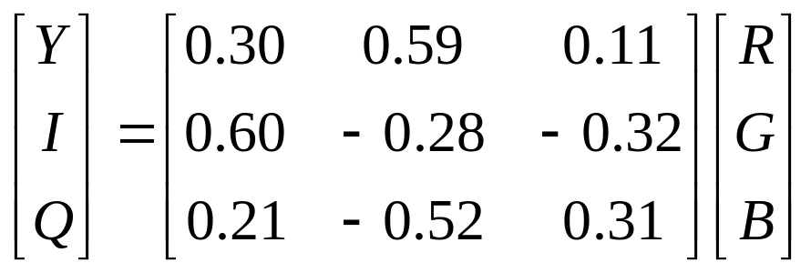
YIQ Color Model
YIQ is the color model used for color TV in America
(NTSC= National Television Systems Committee)
Y is luminance, I & Q are color (I=red/green,Q=blue/yellow)
  Note: Y is the same as CIE’s Y
  Result: backwards compatibility with B/W TV!
Convert from RGB to YIQ:
The YIQ model exploits properties of our visual system, which allows to assign different bandwidth for each of the primaries (4 MHz to Y, 1.5 to I and 0.6 to Q)

Slide 50
YUV Color Model
YUV is the color model used for color TV in Israel (PAL), and in video. Also called YCbCr.
Y is luminance as in YIQ.
U and V are blue and red (Cb and Cr).
The YUV uses the same benefits as YIQ,
(5.5 MHz for Y, 1.3 for U and V).
Converting from RGB to YUV:
  Y = 0.299R + 0.587G + 0.114B
  U = 0.492(B – Y)
  V = 0.877(R – Y)

